Slide 1

Medication Reconciliation Hack-A-Thon
Welcome, Background, Goals and Methods
Thomas Agresta MD, MBI
Professor and Director Medical Informatics
Family Medicine – University of Connecticut SOM
Agresta@uchc.edu
4/5/19

Slide 2
Welcome UConn Health
Andrew Agwunobi MD – CEO of UConn Health
John Dempsey Hospital
University Medical Group
State-wide with PCP and Specialty care
Education and Research as additional parts of mission
Adopted EPIC 1 year ago
Developing an advanced E-Health strategy
Participating as a State Partner in HIE efforts and Use Cases
Very interested in innovation to improve care delivery

Slide 3
UConn Health Vision / Mission
Vision
UConn Health will be nationally recognized for improving the health of the citizens of Connecticut through innovative integration of research, education, and clinical care. To achieve this, UConn Health will:
Mission
UConn Health is dedicated to helping people achieve and maintain healthy lives and restoring wellness/health to maximum attainable levels.
In this quest, we will continuously enable students, professionals and agencies in promoting the health of Connecticut’s citizens. We will consistently pursue excellence and innovation in the education of health professionals; the discovery, dissemination and utilization of new knowledge; the provision of patient care; and the promotion of wellness.

Slide 4
Welcome
Bruce Liang MD - Dean UConn School of Medicine
421 Medical Students
675 Resident physicians
567 Faculty
Vision - excellent care through research, education, and engagement
Mission is innovation, discovery, education and service
https://medicine.uconn.edu/about-us/

Slide 5
UConn SOM - Mission

Slide 6
Welcome
Allan Hackney CISM, CRISC
Health Information Technology Officer (HITO)
Office of Health Strategy
Health Information Exchange in CT
How does a Hackathon help move us forward

Slide 7
OHS

Slide 8
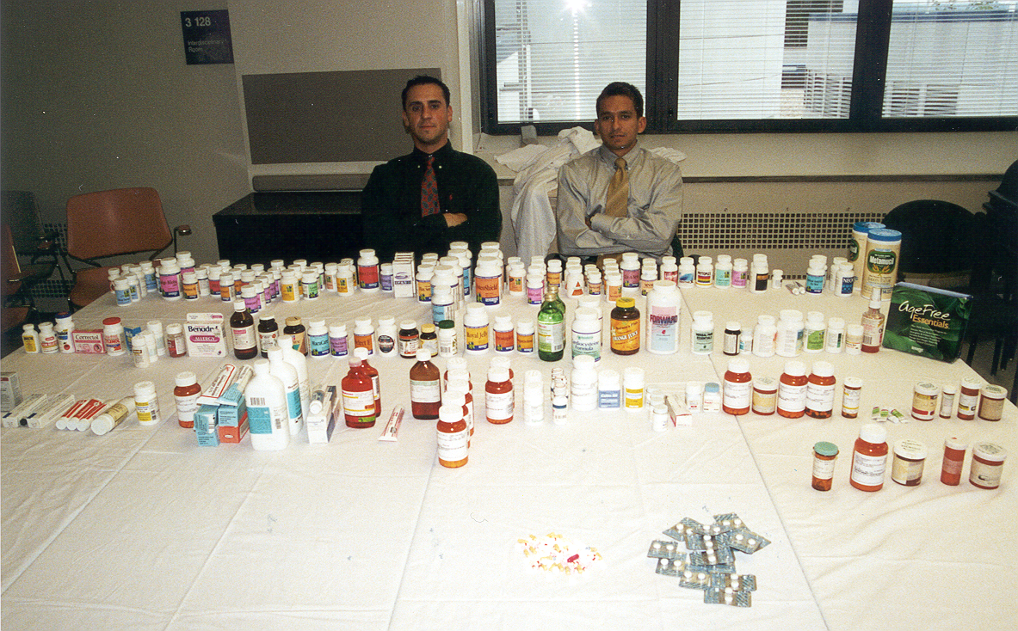

Slide 9
Background WHY A MED REC Hackathon?
Medication Errors are common and many are related to incorrect med lists
Getting A Correct Medication List is Complicated
Technology helps and hurts
ePrescribing –
No more handwritten prescriptions
Introduces unintended errors, difficulty with de-prescribing
Health Information Exchange
Tools to consolidate medication lists from several sources
Yet interoperability between systems is limited
Information & Cognitive Overload
New Interoperability guidance from CMS and Office of National Coordinator
Connecticut has a perfect eco-system to try and introduce creative change

Slide 10
How did we get here?
CT HIE Planning
Med Rec
Polypharmacy Workgroup
Hackathon
Cancel Rx Group
Plan HIE Med Management Services
Spring / Summer 2017
Fall / Winter 2018
Spring / Summer 2019

Slide 11
How did we get here?
CT HIE planning 2017
Med Rec 1 / 10 priorities
Group of Med Informatics professionals - AMIA 2017
Focus first on CancelRx
Informal group ~ 50+ stakeholders / 6 months
Increased awareness / Prep
Report to HIT Advisory CMT
Workflow, ROI and Technical considerations
Legislative hearing 2018
Med Rec and Polypharmacy workgroup
Now under HITO
50+ Stakeholders ~ 6 months
Plan for Med Rec in HIE
Report to CT legislature June 2019
Lessons learned shared in CT and beyond

Slide 12
Who is in the audience?
Clinicians (MD, RN, APRN)
Pharmacist (PharmD)
Computer Scientists (MA, PhD)
EHR Analysts
State Agency (OHS, OSC, DPH, Consumer Protection)
CMIO, CIO, CEO
Patient Advocates
Entrepreneurs
Investors (CT Innovations)
Medical Students
Pharmacy Students
Engineering students (CSE, BME)
MBA students (UConn)
Industry Representatives
Surescripts, CVS
CT HIE entity
Planned Parenthood
Medical Informatics Experts
Faculty UConn, Yale, Temple, Johns Hopkins

Slide 13

Goals
Learn about challenges / opportunities to improve medication reconciliation
Learn about FHIR the newest Interoperability Standard for Health IT
Develop prototype ideas for Med Rec solutions that can inform HIE efforts
Ambulatory Primary Care
Hospital transitions
Skilled Nursing Facility / Home Healthcare
Patients and families
Most important
Have Fun
Be Creative
Innovate
Challenge our Ideas of Status Quo

Slide 14
Desired Outcomes
Clinical & Admin Workgroup
Define problem further
Describe Some Functional Requirements
Describe Components of User interface
User-Centered Design
Technical
Interoperability Standards
FHIR - experience
Develop simple prototype for each Med Rec scenario
Meet a few functional requirements
Gain experience working multidisciplinary teams
Begin Business Requirements
USE Case for HIE Medication Management Service

Slide 15
Create a Medication Source of Truth
Patient Personas
Realistic challenge
See more than one MD
More than one EHR
Need for home list
Source of truth available
Your Solution
FHIR PIT 1
FHIR PIT 2
FHIR PIT 3
OpenEMR
Important Features
Accuracy
User Interface
Actions available
Speed of use
Cognitive load
Identification of potential errors
Meds vary between sources
May have differences in
Dose
Frequency
Generic vs Brand.
Missing or canceled meds
Data granularity

Slide 16
Agenda
Education
Setting the stage – 10 -11:45
Med Wreck (the why)
FHIR a hopeful solution from Health IT Standards
Split into 2 groups 12:30- 2:30
Clinical and Administrative
User-Centered Design Process
Small groups describe desired functions / layout of solutions
Technical
Deeper dive into how FHIR works / Examples of solutions
Review and practice with FHIR-PITS and OpenEMR infrastructure

Slide 17
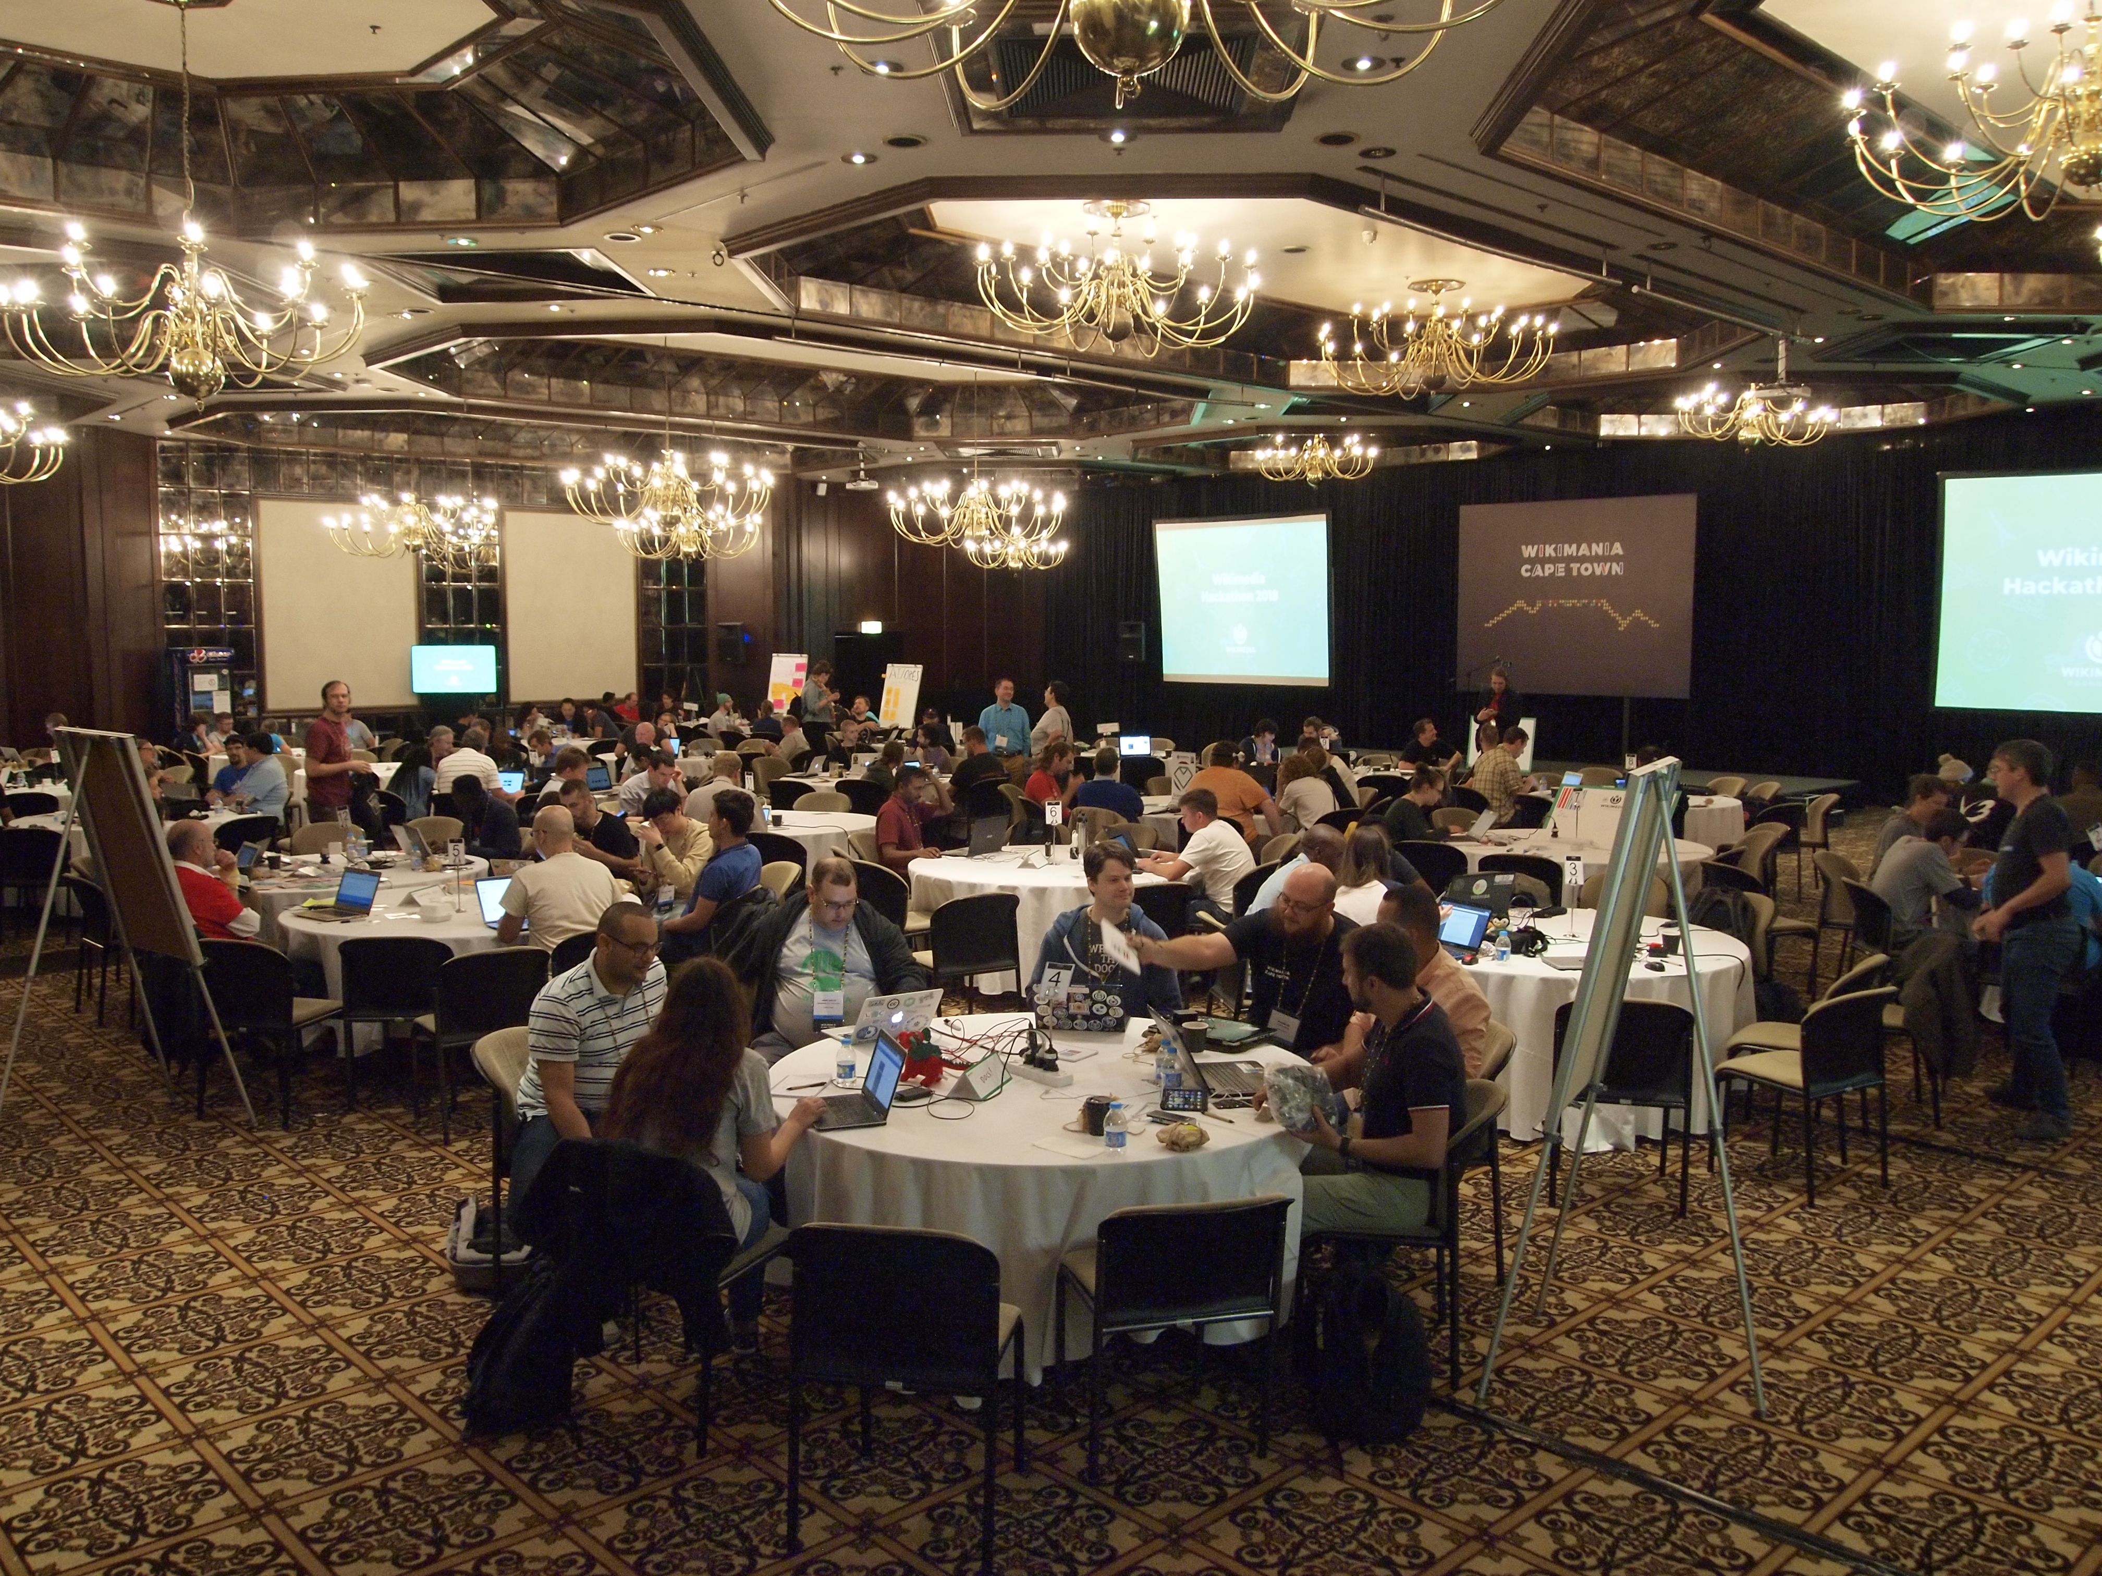
Agenda
Group Formation – 2:30 – 3:00
Clinical / Admin – Pitch ideas (5 mins)
Hack in mixed small groups 3:00 – 5:00 ++
Clinical, Admin, Technical
Subject matter expert / mentors
Saturday
Hack 8 – 10
Clinical / Admin 10 - 11
additional root cause analysis
Suggestions for long-term solutions
Technical – Hack 10 – 11
Hack in small groups 11 – 2
Presentation of solutions 2- 4
Group Discussion 4 – 5

Slide 18
Thanks to:
Our Leadership & Support Teams
UConn Health
CT Office of Health Strategy
UConn AIMS
UConn Storrs – Computer Science and Engineering
CT HIE Entity
Velatura
eHealth CT & SMC Partners

Slide 19









Thanks to our Sponsors
Notes:
Thank you to Office of Health Strategy for funding this event and UConn SOM for letting us host
Gold Sponsor: $2,500 toward catering costs: UConn Foundation- Dr. Agunowbi, CVS Health
• Silver Sponsor: $1,000 toward individuals meals: SureScripts, HIMSS NE, Society for Information Management (SIM)
• Bronze Sponsor $300-500: SMC Partners, UConn School of Pharmacy & The CT Health Foundation

